Slide 1
The Battle of the Neighborhoods: Amsterdam and its Boroughs
By Robert B.

Slide 2
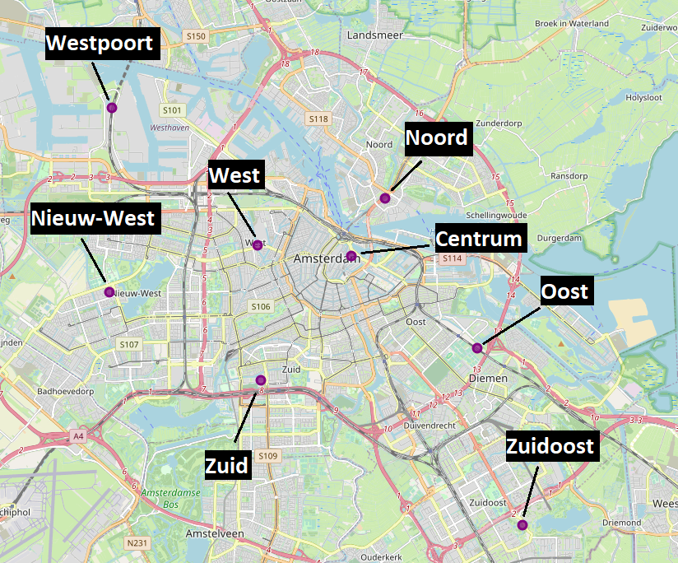
The 8 Boroughs in Amsterdam

Slide 3
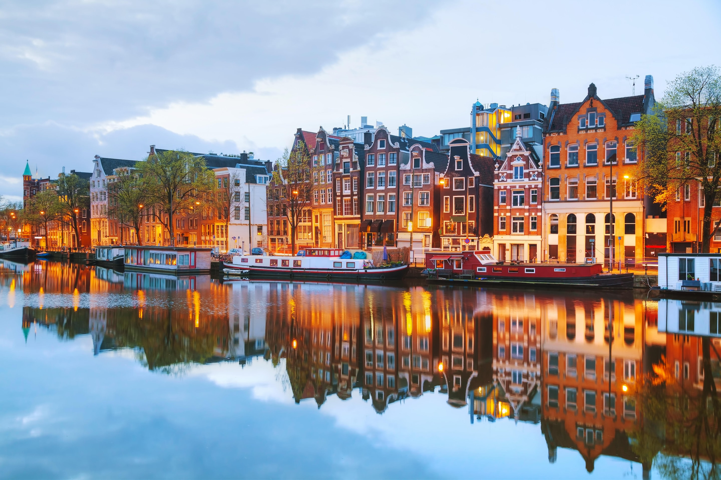
Introduction
Amsterdam has been around since the 13th Century
One of the biggest cities for tourism in Europe
Very densely populated (800,000+ residents!)
Source: https://www.telegraph.co.uk/content/dam/insurance/2016/04/06/amsterdam.jpg

Slide 4


Problem: Which neighborhoods in Amsterdam are the best to go to? Which are safest? Which are busiest? Where are the venues?
People who might be interested in this: tourists and Dutch citizens
Source: https://www.adweek.com/files/2015_May/iStock-Unfinished-Business-6.jpg https://img.huffingtonpost.com/asset/5e4f03482300005b0539bde3.jpeg?ops=scalefit_630_noupscale

Slide 5
Data - Coordinates
 | Neighborhood | Latitude | Longitude | Population Density (people/km²)
0 | Centrum | 52.37321 | 4.903712 | 13748
1 | Westpoort | 52.41095 | 4.803871 | 10
2 | Zuidoost | 52.30465 | 4.974994 | 4391
3 | West | 52.37611 | 4.86452 | 15252
4 | Nieuw-West | 52.36407 | 4.802676 | 4478
5 | Oost | 52.34981 | 4.956049 | 7635
6 | Zuid | 52.34172 | 4.86605 | 9349
7 | Noord | 52.388 | 4.917663 | 2269

Slide 6
Data – Common Venues
 | Neighborhood | 1st Most Common Venue | 2nd Most Common Venue | 3rd Most Common Venue
0 | Centrum | Bar | Hotel | Coffee Shop
1 | Nieuw-West | Soccer Field | Theater | Gym / Fitness Center
2 | Noord | Plaza | Yoga Studio | Bed & Breakfast
3 | Oost | Soccer Field | Hockey Field | Playground
4 | West | Nightclub | Snack Place | Supermarket
5 | Westpoort | Heliport | Harbor / Marina | Yoga Studio
6 | Zuid | Bagel Shop | Office | Supermarket
7 | Zuidoost | Farm | Harbor / Marina | Park

Slide 7
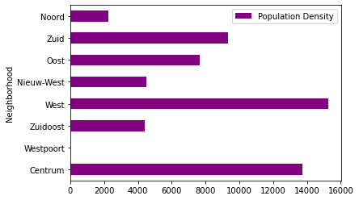
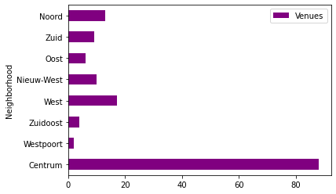
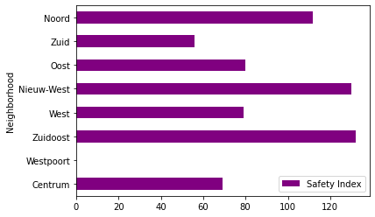
Data – Bar Charts
Westpoort super low population density
Centrum has a lot of venues
Safety Index > 100 is deemed “unsafe”

Slide 8
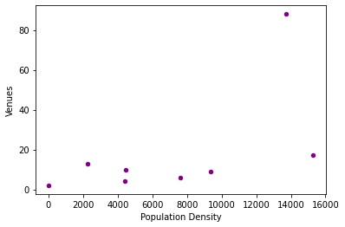
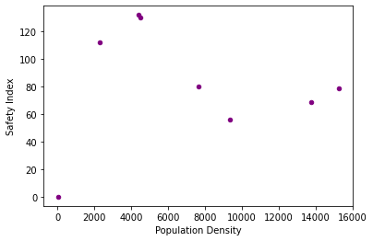
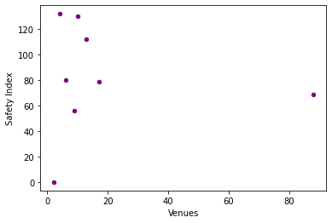
Data – Scatter Plots
Huge outliers in each scatterplot graph
No clear relationships or correlations visible
Not enough data points to make an accurate estimate regarding trends

Slide 9
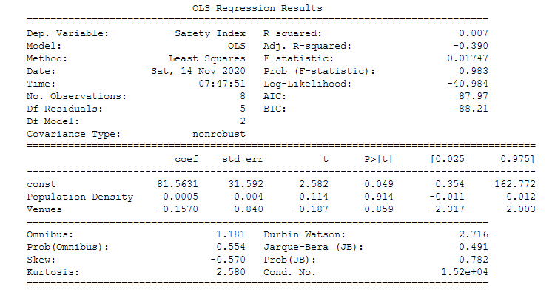
Regression
Very small positive coefficient for Population Density, implying that an increase in population density does see an increase in crime
A negative coefficient for Venues, implying that as more venues are added to a district, crime surprisingly drops
The huge P values (and tiny R^2 value) show that all of this is completely insignificant, statistically speaking, and proves that a far greater number of observations is needed for any meaningful findings

Slide 10
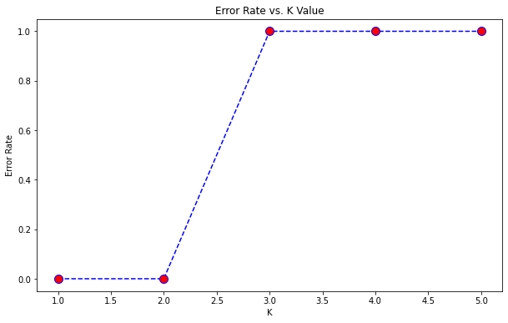
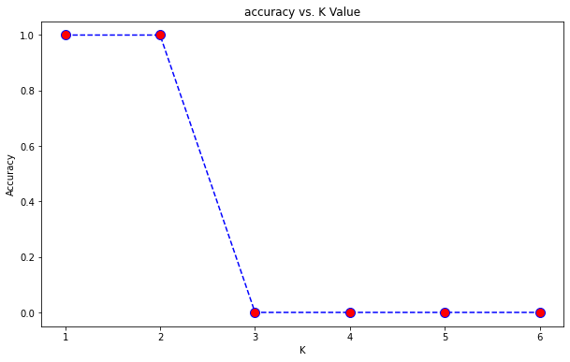
K Nearest Neighbor – Finding the Optimal Value of K
Important to find the K value at which Accuracy is HIGHEST
Also find the value of K at which the Error Rate is LOWEST
Optimal value of K appears to be 2
Therefore, we will have two clusters into which the eight boroughs will be divided

Slide 11
KNN - Clusters
 | Neighborhood | Latitude | Longitude | Venues | Population Density | Safety Index | Safe | Cluster labels
0 | Centrum | 52.37321 | 4.903712 | 88 | 13748 | 69 | 1 | 1
1 | Westpoort | 52.41095 | 4.803871 | 2 | 10 | 0 | 1 | 0
2 | Zuidoost | 52.30465 | 4.974994 | 4 | 4391 | 132 | 0 | 1
3 | West | 52.37611 | 4.86452 | 17 | 15252 | 79 | 1 | 1
4 | Nieuw-West | 52.36407 | 4.802676 | 10 | 4478 | 130 | 0 | 1
5 | Oost | 52.34981 | 4.956049 | 6 | 7635 | 80 | 1 | 1
6 | Zuid | 52.34172 | 4.86605 | 9 | 9349 | 56 | 1 | 1
7 | Noord | 52.388 | 4.917663 | 13 | 2269 | 112 | 0 | 1

Slide 12
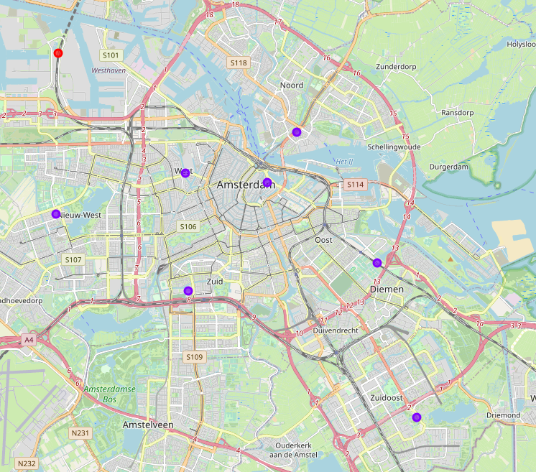
KNN Clusters - Mapped

Slide 13
Results
Graphs show little to no correlation between the target variables
Several outliers are noticeable on the graphs – Centrum is clearly the busiest and most popular district
Westpoort, in particular, is a strange outlier. This is likely due to it being an industrial work zone, as opposed to a residential or commercial place
Regressions shows a potential negative effect of additional venues on crime, while population density has a minute positive effect
Far too few observations were used to find anything meaningful in the regression, with P values so large that it is entirely insignificant
Clustering with KNN supports the idea that Westpoort is very much the “odd one out” when it comes to districts in Amsterdam
Surprisingly, clustering did not single out Centrum, even though it has way more venues and attractions than any other district by far

Slide 14
Discussion & Recommendations
Better to use the neighborhoods within each district next time, that way there will be more data points (42 as opposed to 8) and results might be a lot more conclusive
As someone who was born and raised in Amsterdam, I couldn’t help but notice that Foursquare had mislabeled many venues, putting them in the wrong districts… This should be fixed if anyone wants to gather data on Amsterdam from there

Slide 15
Conclusions
While it might have been incredibly obvious already, this little study does show that an industrial work zone like Westpoort is NOT the best place to visit as a tourist, nor to live in as a resident
Despite being incredibly busy and full of venues, Centrum is actually more safe than other, more residential, areas

